Slide 1
Report 03/26/2020
P. Hacker

Slide 2
Agenda: Line of Sight Geometry and Local Emissivity
investigate intrinsic dependency of chordal profile to line of sight (LoS) geometry
therefore deliberately change detector arrangement/geometry in pre-processing:
fixing possible non-planar distribution; relative to plane created by one side of detector fan and aperture normal vector (only HBCm possible, aperture centered)
transforming detector fan from tilted plane in toroidal direction to vertical arrangement at 107.94° (tor. angle)
tilting detector fan in poloidal direction up/down by -1.0° <-> 5.0°
changes in geometry matrix from LoS geometry used in forward integration of poloidally symmetric STRAHL simulation results (line radiation of impurity carbon)

Slide 3
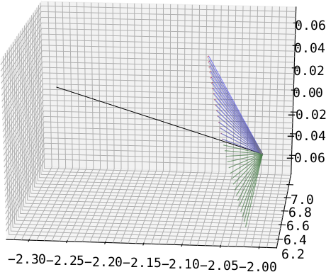
1.: ‘Fix’ Bolometer Planar Error
guided by lower half of detector array (green)
observe difference (red) between opposite channel (e.g. CH#0 <-> CH#31) through rotating around aperture normal by 180° and measuring angle
transforming second channel through rotating it by angle from before (blue)
only really easy for HBCm, because central aperture axis alignment; VBC cameras not possible
aperture
‘fixed’
HBCm
guide

Slide 4
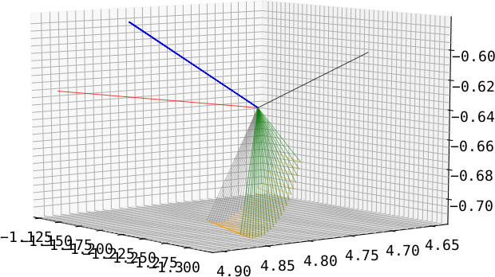
2.: Toroidal Transformation to Axis Plane
guide is normal of plane constructed by detector fan (blue)
transforming all channels so that normal points in/at toroidal direction (red)
transformation for each channel individual (see previous argument (1.)) (orange)
done for all cameras individually
old normal(s)
aperture normal
target normal
old fan
new fan
VBCr

Slide 5
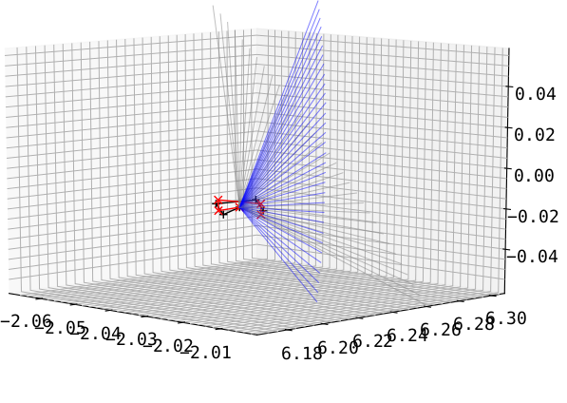
3.: Tilting the Detector Fan Up/Down
take results of (2.) and tilt the entire fan including the aperture poloidally (grey to blue and black to red)
HBCm
(results for (2.) with aperture change included)

Slide 6
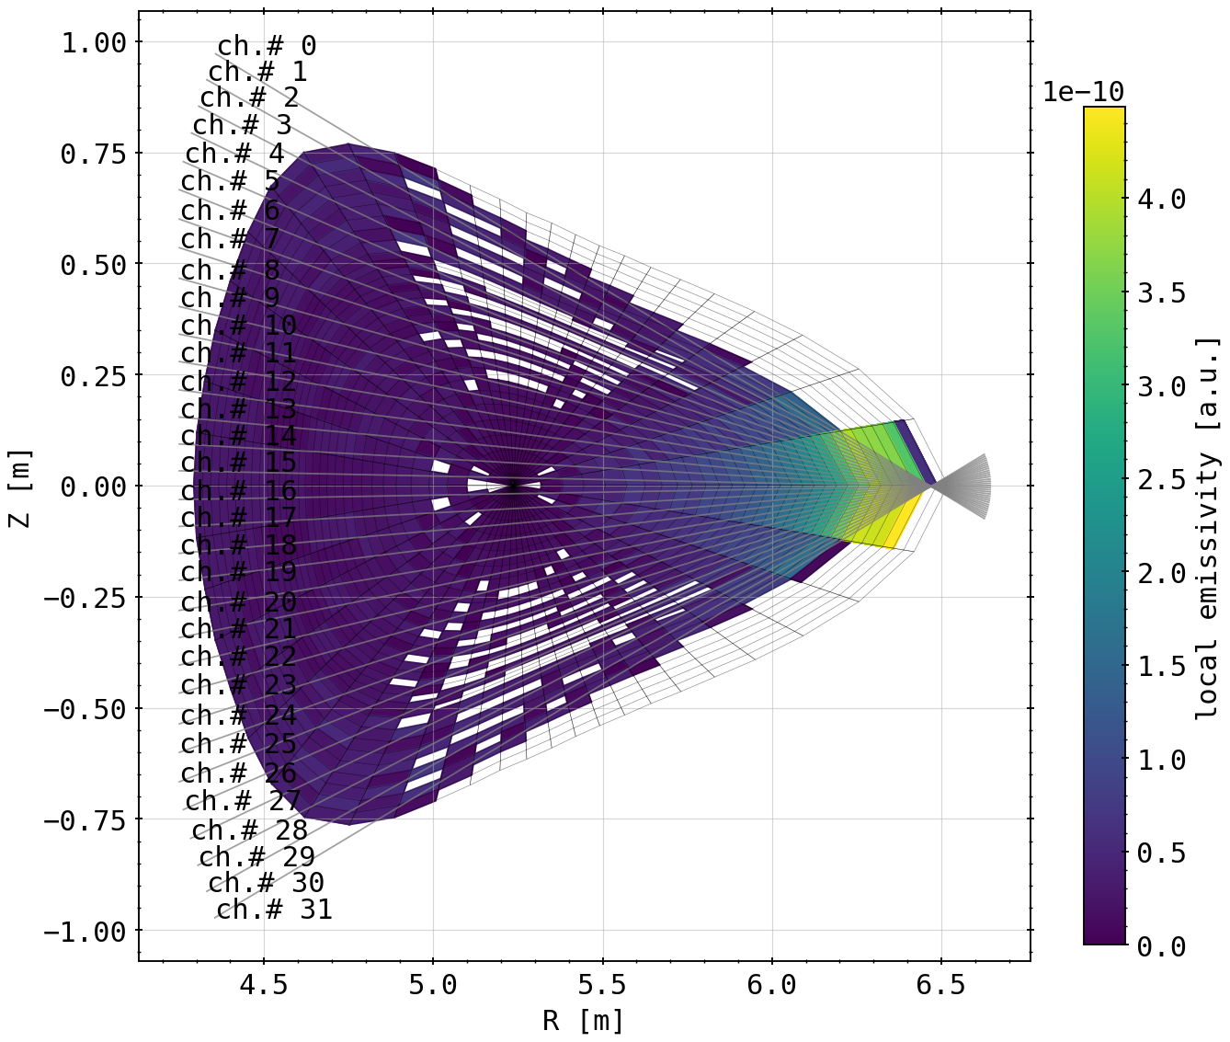
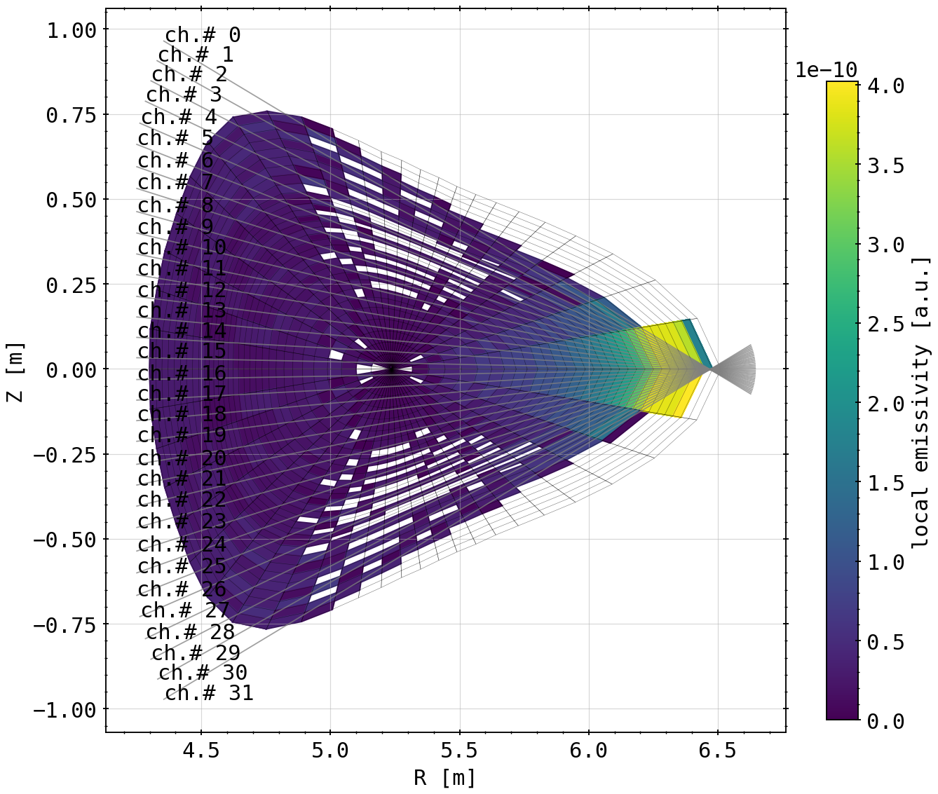
‘Standard’ Case vs. Planar Fix
artifact?
artifact?
somewhat more equal distribution in front of aperture
strong orientation along LoS because of mesh transformation
(geometry matrix in Bolometer plane)
(geometry matrix in Bolometer plane with ‘fixed’ LoS)

Slide 7
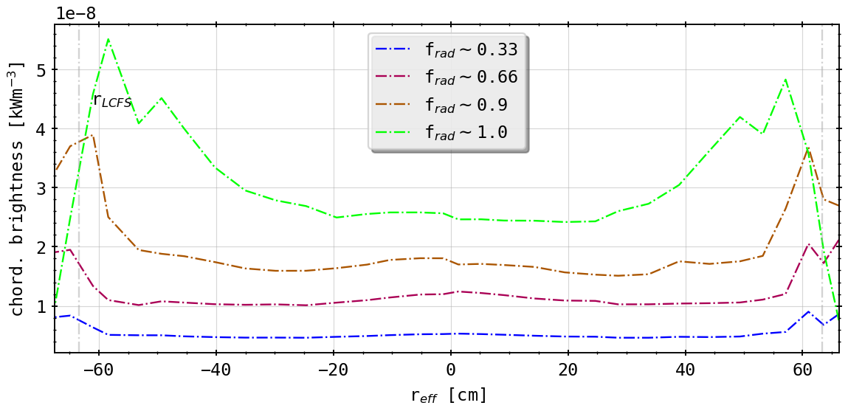
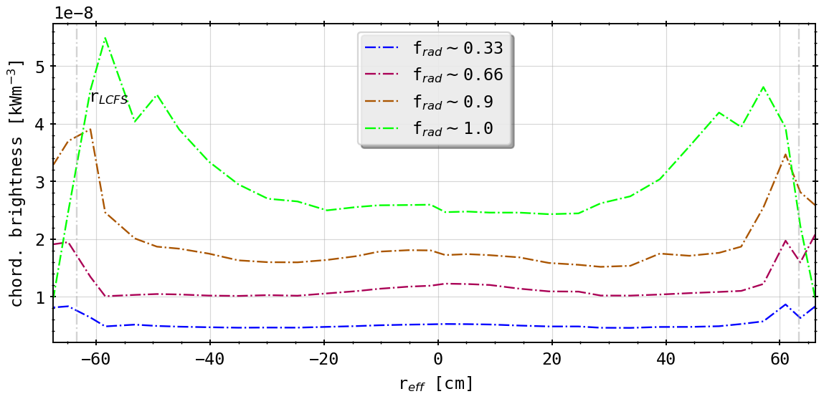
‘Standard’ Case vs. Planar Fix
(forward integration of STRAHL simulations)
(forward integration of STRAHL simulations with ‘fixed’ LoS)
virtually no changes?

Slide 8
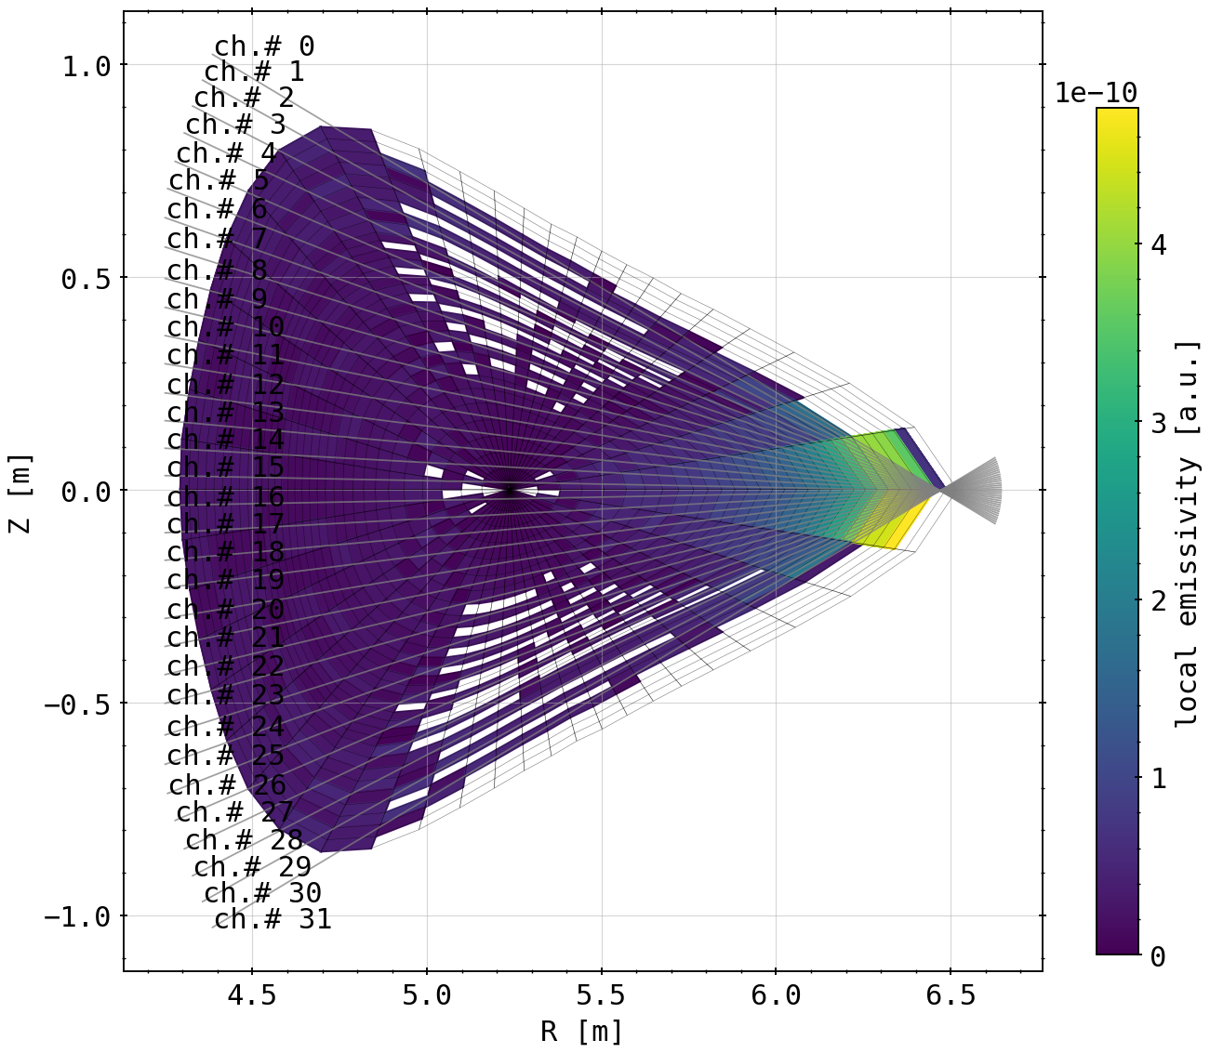
‘Standard’ Case vs. Toroidal Transformation
fluxsurfaces and mesh geometry for matrices looks different since it is no longer a toroidal projection
artifact?
artifact?
still asymmetry visible in front of aperture already
(geometry matrix in Bolometer plane)
(geometry matrix in Bolometer plane at 108° with symmetric LoS orientation)

Slide 9
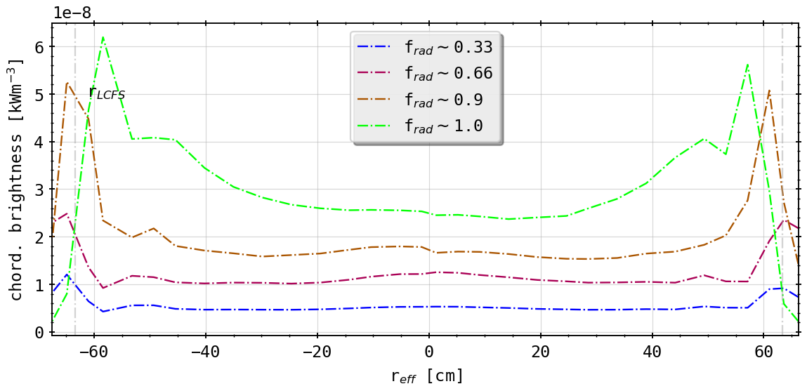
‘Standard’ Case vs. Toroidal Transformation
(forward integration of STRAHL simulations)
(geometry matrix in Bolometer plane at 108° with symmetric LoS orientation)
qualitatively small changes: SOL radiation zones now more peaked and very sharply located
radially no difference in forward calculation
comparatively same level of asymmetry remains (fault in own calculation?)

Slide 10
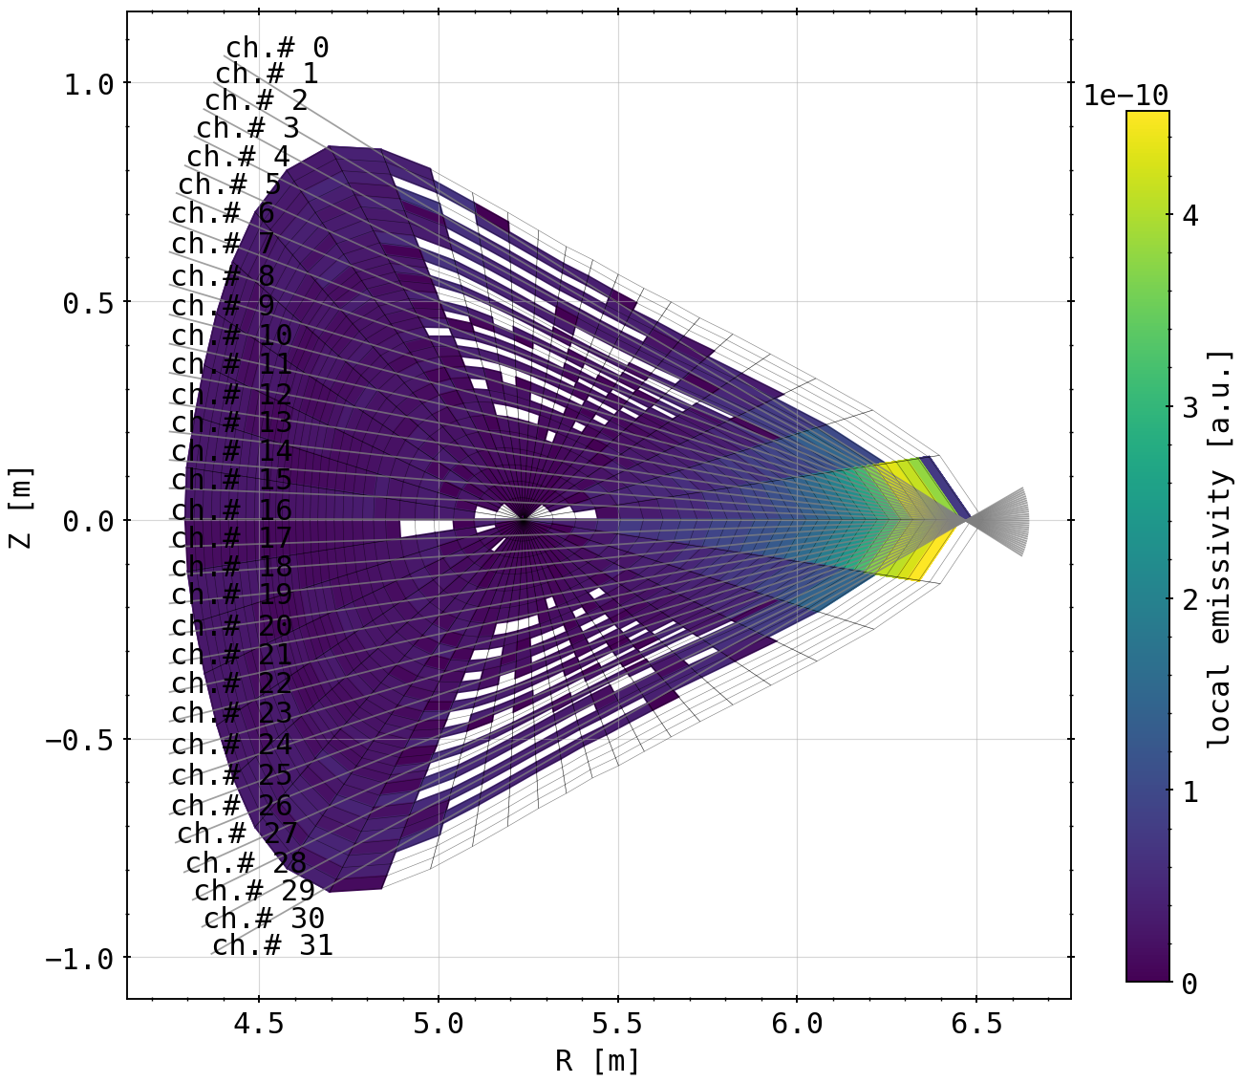
‘Standard’ Case vs. Toroidal Transformation and Tilt
artifact?
still artifact?
(geometry matrix in Bolometer plane)
(geometry matrix in Bolometer plane at 108° with symmetric LoS orientation and -1.0° tilt (up))

Slide 11
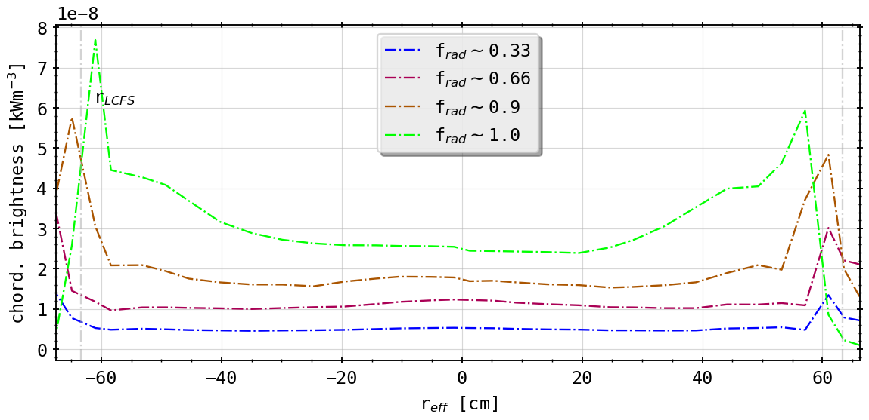
‘Standard’ Case vs. Toroidal Transformation and Tilt
(forward integration of STRAHL simulations)
(geometry matrix in Bolometer plane at 108° with symmetric LoS orientationand -1.0° tilt (up))
asymmetry becomes stronger
left hand side (down in cell plot) or ‘negative’ radius became more peaked again
alignment with fluxsurfaces better
also radial movement of radiation peaks further out (instead of inwards)

Slide 12
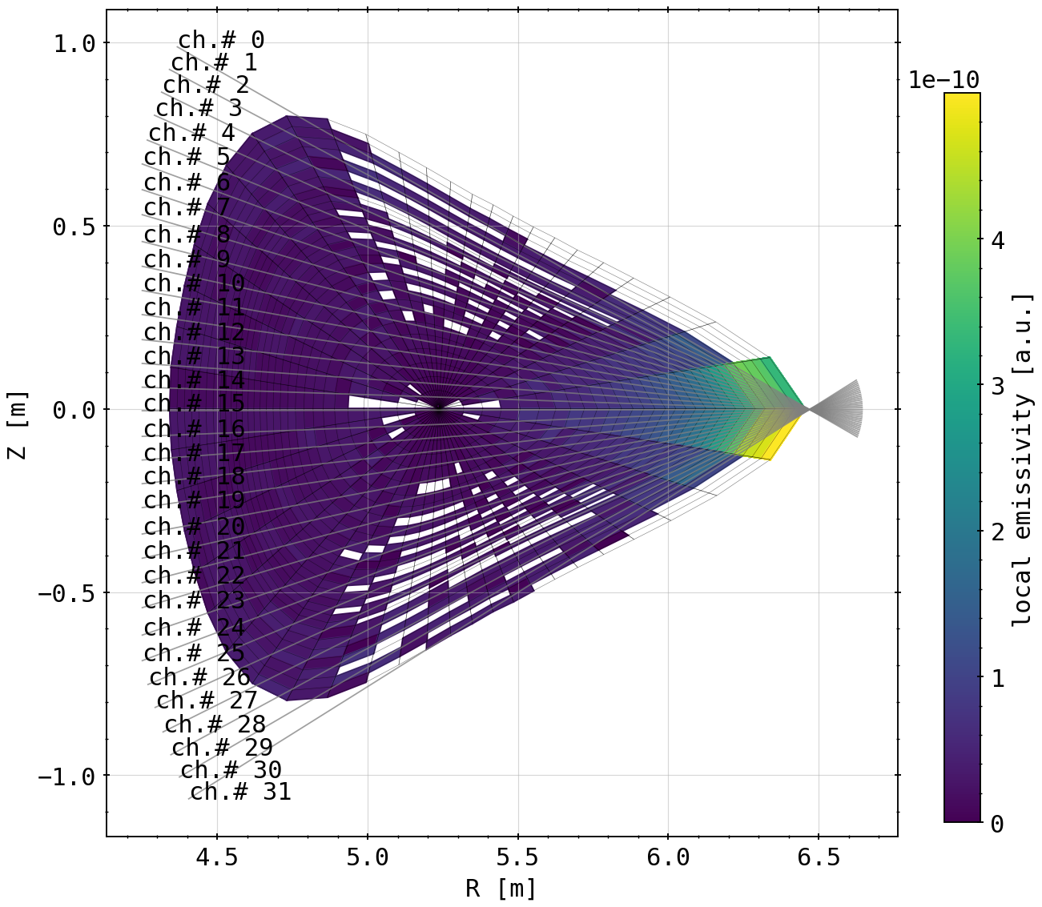
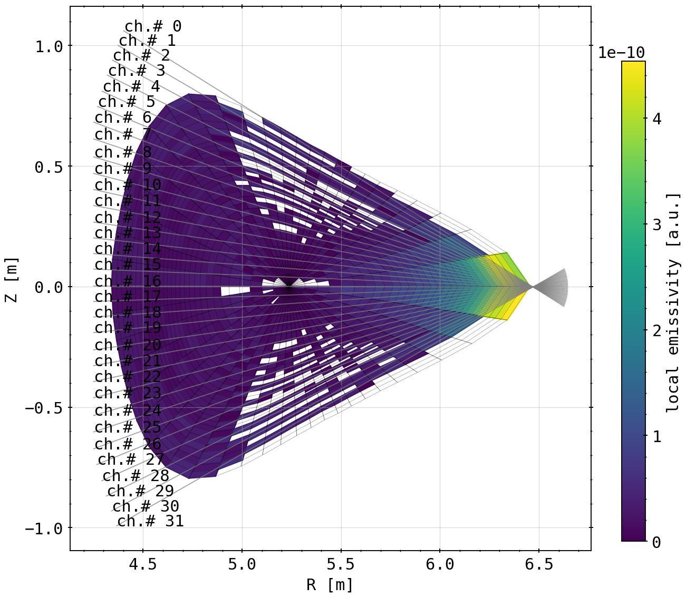
Different Tilts
(1.0° tilt (down))
(-1.0° tilt (up))

Slide 13
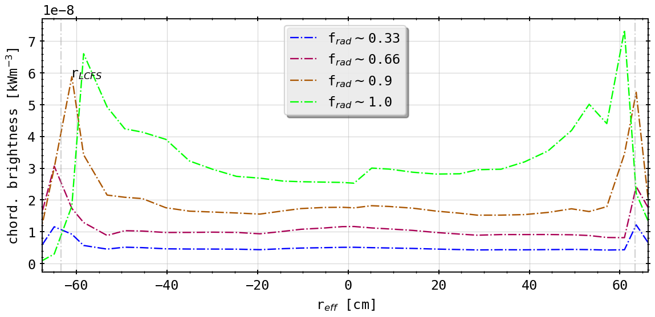
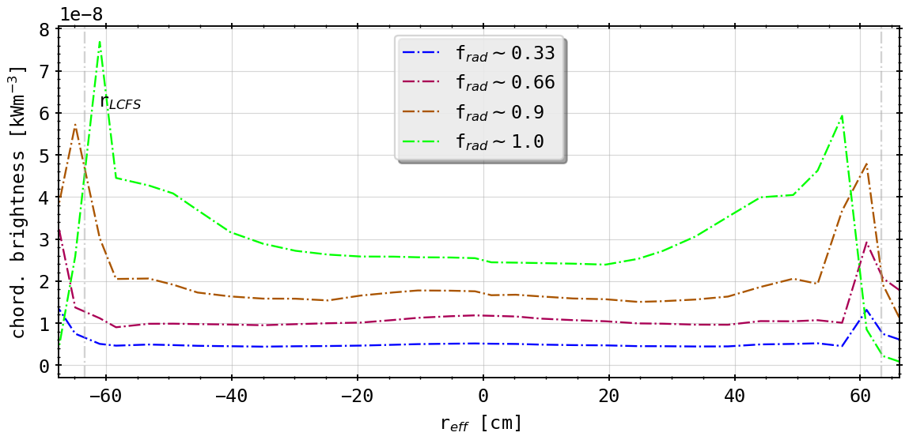
Different Tilts
(1.0° tilt (down))
(-1.0° tilt (up))
asymmetry switched around
alignment better now upside (tilt down!)
likewise radial movement as before!

Slide 14
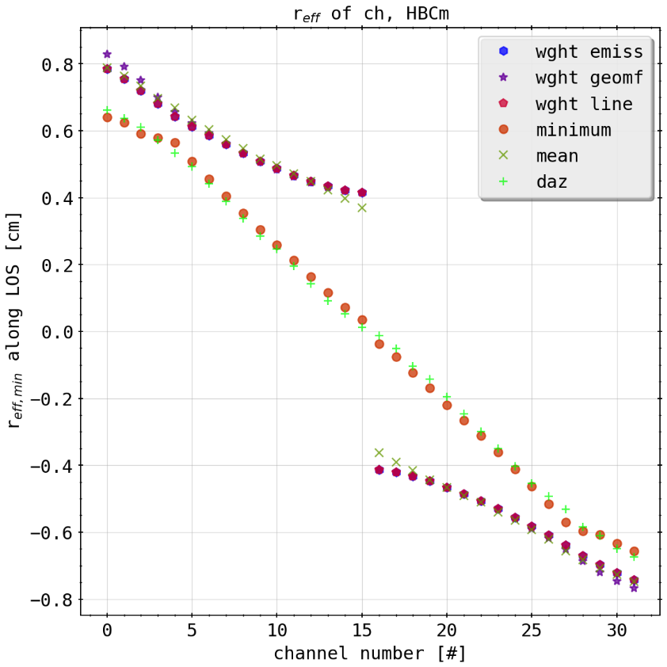
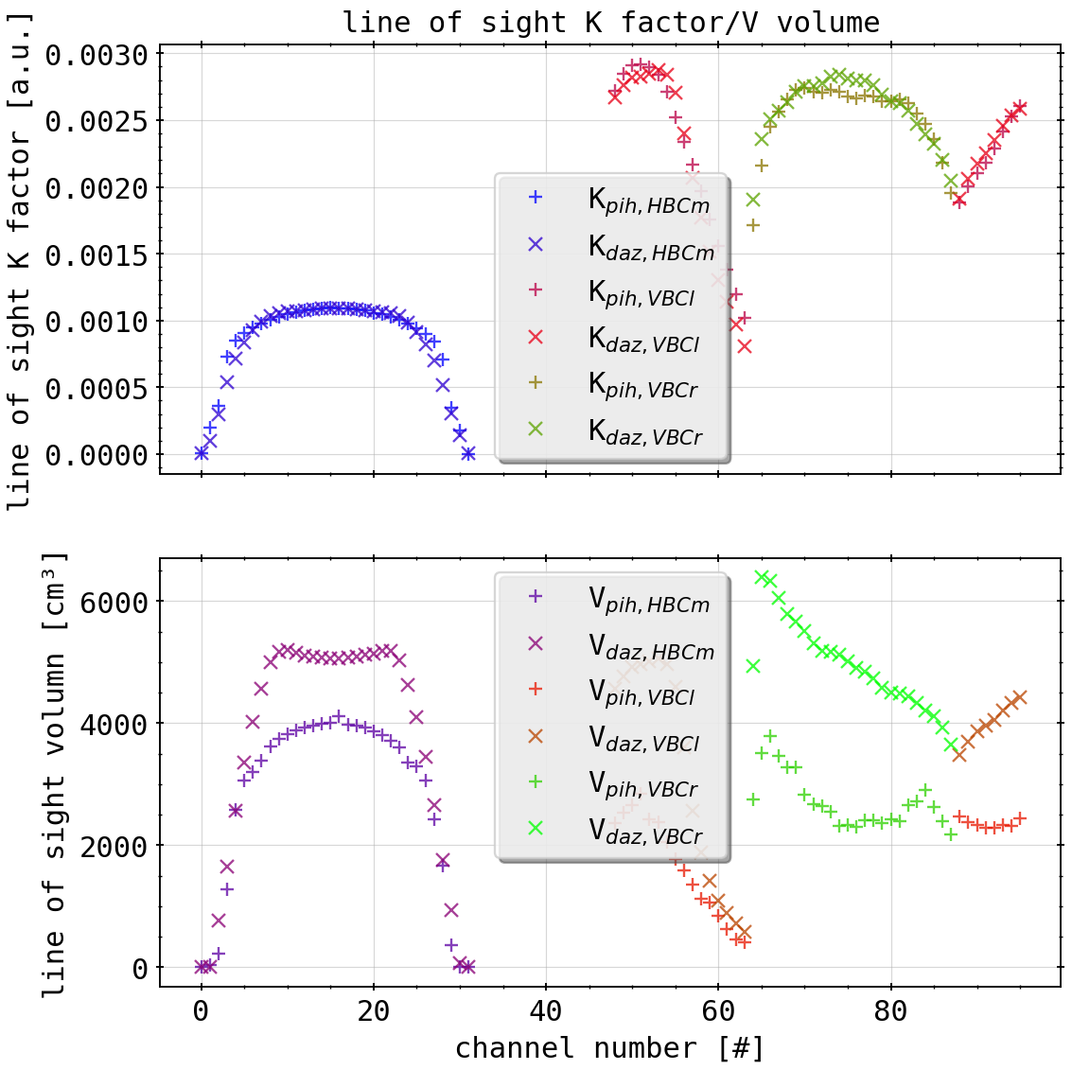
Preliminary Conclusions
intrinsic tilt and toroidal shift indicate the asymmetry from inherently symmetric radiation distribution
possibly flawed inversion if geometry used?
symmetric chordal profiles produced by 0.5° tilt down (from STRAHL)
(effective radii with also different weighting methods)
(K factors and LoS volumes from simple 2D projection)

